Slide 1
LA’s BEST @USC
Genetics, Geography, & Genome-wide Association Studies
Nick Mancuso, PhD

Slide 2

About Me
Nick Mancuso, PhD
He/Him
Assistant Professor in Biostatistics
Computer Science BS & PhD @ GSU
Postdoc in Statistical Genetics @ UCLA
Interested in understanding genetic basis for complex disease
Complex traits too!
Photo that will be wildly outdated, yet still on my website one day

Slide 3


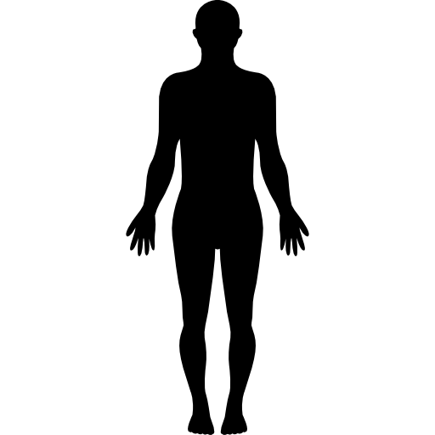

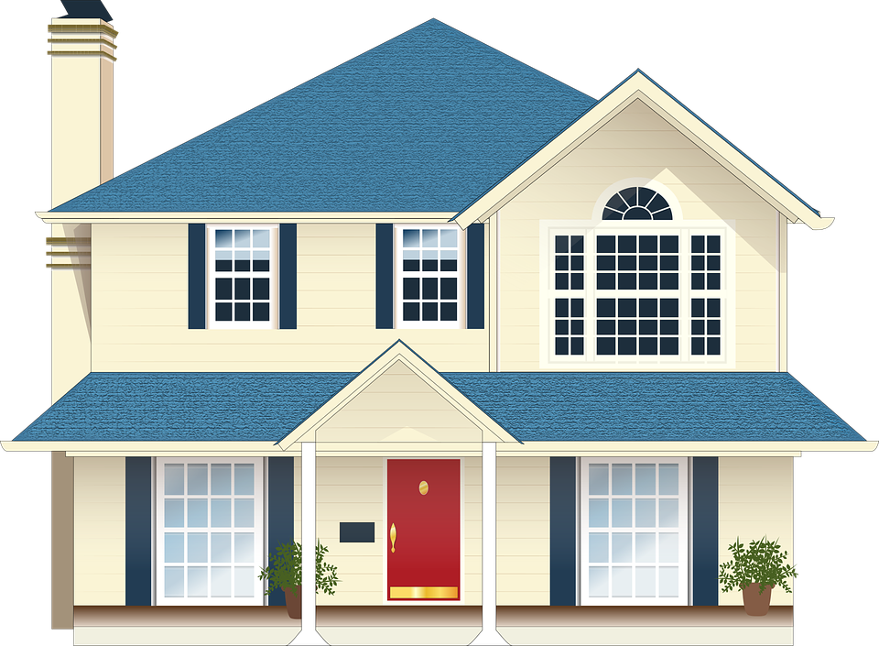


Phenotype = f(Genetics, Environment)
=
+
phenotype
genetic variations
environmental variations
Why do we study genetics?
Understand the biological mechanism of traits and diseases
Improve diagnosis of certain genetic disorders
Help develop personalized medicine

Slide 4
Big Picture Goals
Understand basic principles and history of genetics
Eugenics to genetics
Inheritance patterns
Understand what questions we can ask about complex disease risk using genetic and phenotypic data
“Does inherited genetics play a role in disease risk?
“If so, which genes are responsible?”
Understand the statistical models underlying these questions
Generalized linear model, linear mixed model
Understand the limitations, caveats, concerns
“Are genetic associations with disease risk immune to confounding?”
“How can GWAS exacerbate health disparities?”

Slide 5
Outline
Molecular genetics primer
Biology and history of the field
Characterizing genetic variation
Within and across populations
Genome-wide association studies
Linear and linear mixed model
Polygenic Risk Scores

Slide 6
Molecular Genetics Primer

Slide 7
Molecular genetics primer
Genetic material is DNA
Inherited from parents
Located in nucleus and mitochondria
(For eukaryotes)
Most mature cells contain DNA
https://en.wikipedia.org/wiki/Chromosome

Slide 8
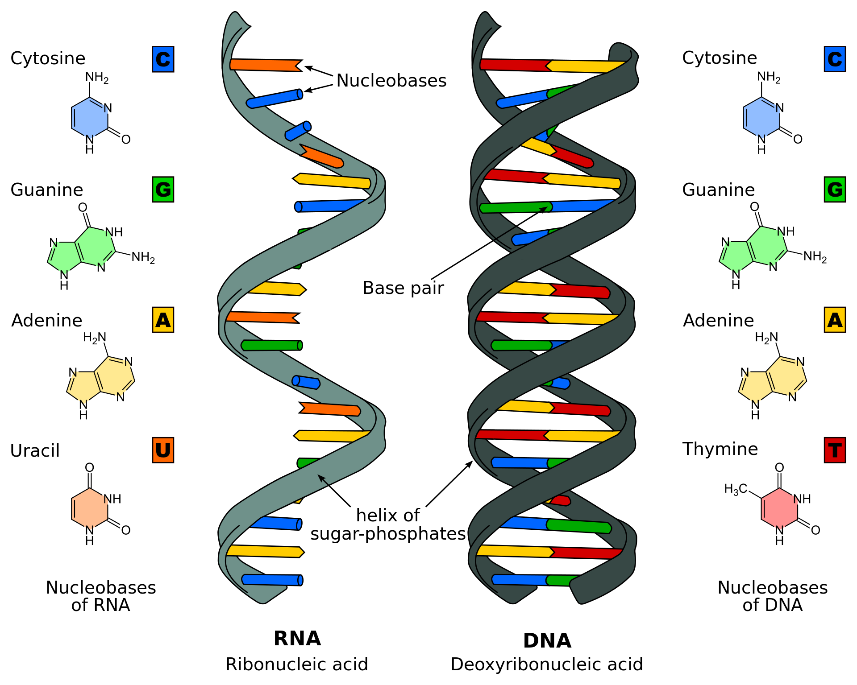
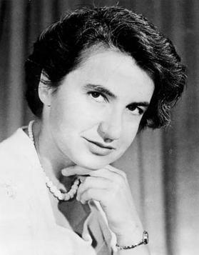
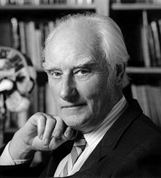
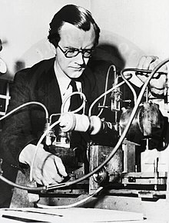
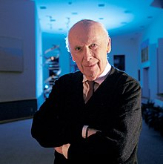
Nucleic Acids, RNA, & DNA
Rosalind Franklin
Francis Crick
Maurice Wilkins
James Watson
https://en.wikipedia.org/wiki/Nucleic_acid

Slide 9
Genetic variation
Variation reflects differences in DNA among individuals/populations
Introduced through mutation and recombination
Sources of mutation (mutagenesis):
Spontaneous, errors during replication, errors during repair, etc.
Common mutation types
Single-nucleotide polymorphism (SNP; pronounced “snip”)
Small insertions or deletions (indel)
Large gene duplications, translocations, inversions, etc

Slide 10
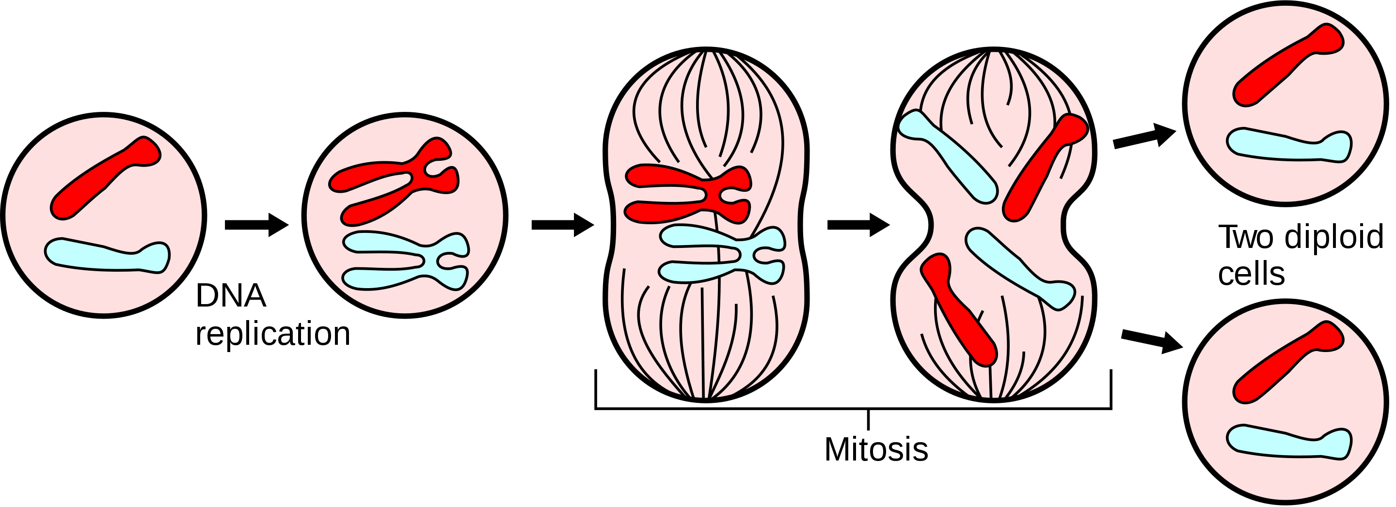
DNA replicates through mitosis and meiosis
DNA replication -> cell division
Does not contribute to genetic variation in a population
https://en.wikipedia.org/wiki/Mitosis

Slide 11
DNA replicates through mitosis and meiosis
DNA replication -> recombination -> cell division x2
Does contribute to genetic variation in a population
https://en.wikipedia.org/wiki/Meiosis

Slide 12
Genetic recombination and linkage
A
A
a
a
A
A
a
a
B
B
b
b
B
b
B
b
C
C
c
c
C
c
C
c

Slide 13
Genetic recombination and linkage
A
A
a
a
Non-recombinants
Non-recombinants
Recombinants
Recombinants
B
b
b
B
C
c
c
C

Slide 14
Genetic recombination and linkage
The further the physical distance between genes along a chromosome, the higher the probability a recombination event will occur between them
Recombination rate is higher in females compared to males
Recombination occurs roughly (VERY ROUGHLY) in proportion to chromosome length
Poisson process, Haldane 1919
The recombination fraction (q) is the proportion of gametes that are recombinants or that undergo an odd number of cross-over events
Thomas Hunt Morgan, 1916
wikipedia.org

Slide 15
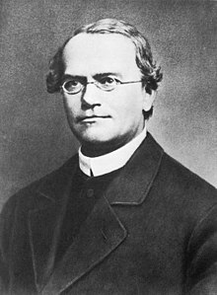
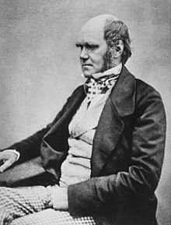
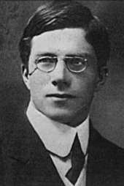
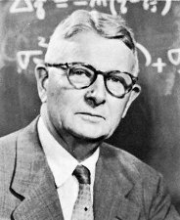
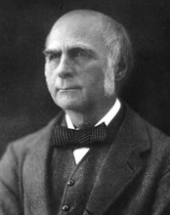
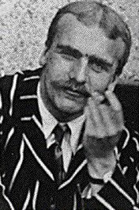
Brief history on foundations of genetics
1856-1863
1859-1871
1871~1890
1911~
Mendelian genetics
Natural selection + evolution
Biometricians and Population genetics
Gregor Mendel
Charles Darwin
RA Fisher
Sewall Wright
Francis Galton
https://github.com/cooplab/popgen-notes
JBS Haldane

Slide 16
Brief reminder on foundations of eugenics
Founded on the unscientific notion “genetically inferior” individuals are “unfit” to reproduce
Translated into beliefs about race
Fueled policy in US and UK in early 20th century
Forced sterilization of Black, Latino, and Indigenous
CA had law on books until 1972 that disproportionately affected Latino individuals
Scientists across decades have pushed back
E.g., Thomas Morgan, Theodosius Dobzhansky, Richard Lewontin
We must thoughtful in how we conduct genetic research!
Francis Galton
RA Fisher
https://github.com/cooplab/popgen-notes

Slide 17
Characterizing genetic variation

Slide 18
First, some definitions
Locus (plural loci) refers to a genomic region
Bit ambiguous -> entire gene? Single variant?
Allele refers to a particular variant at a locus
E.g., ‘G>C’ mutation where ‘X>Y’ means ‘Y’ replaced ‘X’ by mutation
Allele frequency refers to the freq/prob of observing allele in a population
Genotype refers to genetic information in an individual
E.g., AA, Aa, aa for some alleles A, a -> recode as 0, 1, 2
Also, a bit ambiguous -> entire genome? Single variant?
Genotype frequency refers to the freq/prob of observing genotype in a population

Slide 19
Allele frequency estimation
Allele frequencies are used in population genetics to study structure, dynamics, and evolution
Forms the building blocks of genetics
Population, quantitative, and statistical
Given random individuals, can use allele counting to determine frequency
Related individuals are more complicated and can lead to loss of information
Example
N | Allele | A₁A₁ | A₁A₂ | A₂A₂ | Total
Individuals |  | 30 | 60 | 10 | 100
Alleles | A₁ | 60 | 60 | 0 | 120
 | A₂ | 0 | 60 | 20 | 80
Pr(A₁) = ?
Pr(A₂) = ?

Slide 20
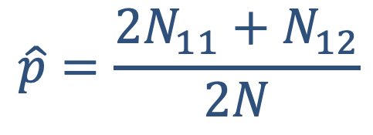
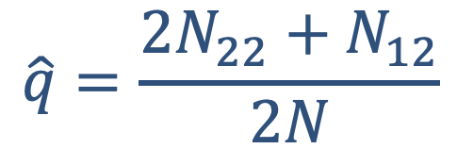
Allele frequency estimation
Let A₁, A₂ be two alleles at a bi-allelic locus with frequencies p, q
Let N₁₁, N₁₂, N₂₂ denote 1-1 homozygotes, heterozygotes, and 2-2 homozygotes, with N = N₁₁ + N₁₂ + N₂₂
How can we infer p, q?
N | Allele | A₁A₁ | A₁A₂ | A₂A₂ | Total
Individuals |  | 30 | 60 | 10 | 100
Alleles | A₁ | 60 | 60 | 0 | 120
 | A₂ | 0 | 60 | 20 | 80
$$\hat{p}=\frac{2N_{11}+N_{12}}{2N}$$
$$\hat{q}=\frac{2N_{22}+N_{12}}{2N}$$
p = 120/200=60%
q = 80/200=40%

Slide 21
Hardy Weinberg Equilibrium (HWE)
Assume a population with
No inbreeding
Is not under selection
No diff in allele freq between sexes
Mates randomly
How can we model alleles being sampled in a (large) population?
Sample with replacement -> binomial sampling!
Pr(A₁A₁) = p²
Pr(A₁A₂) = 2pq
Pr(A₂A₂) = q²

Slide 22
MLE for MAF under HWE
What?

Slide 23
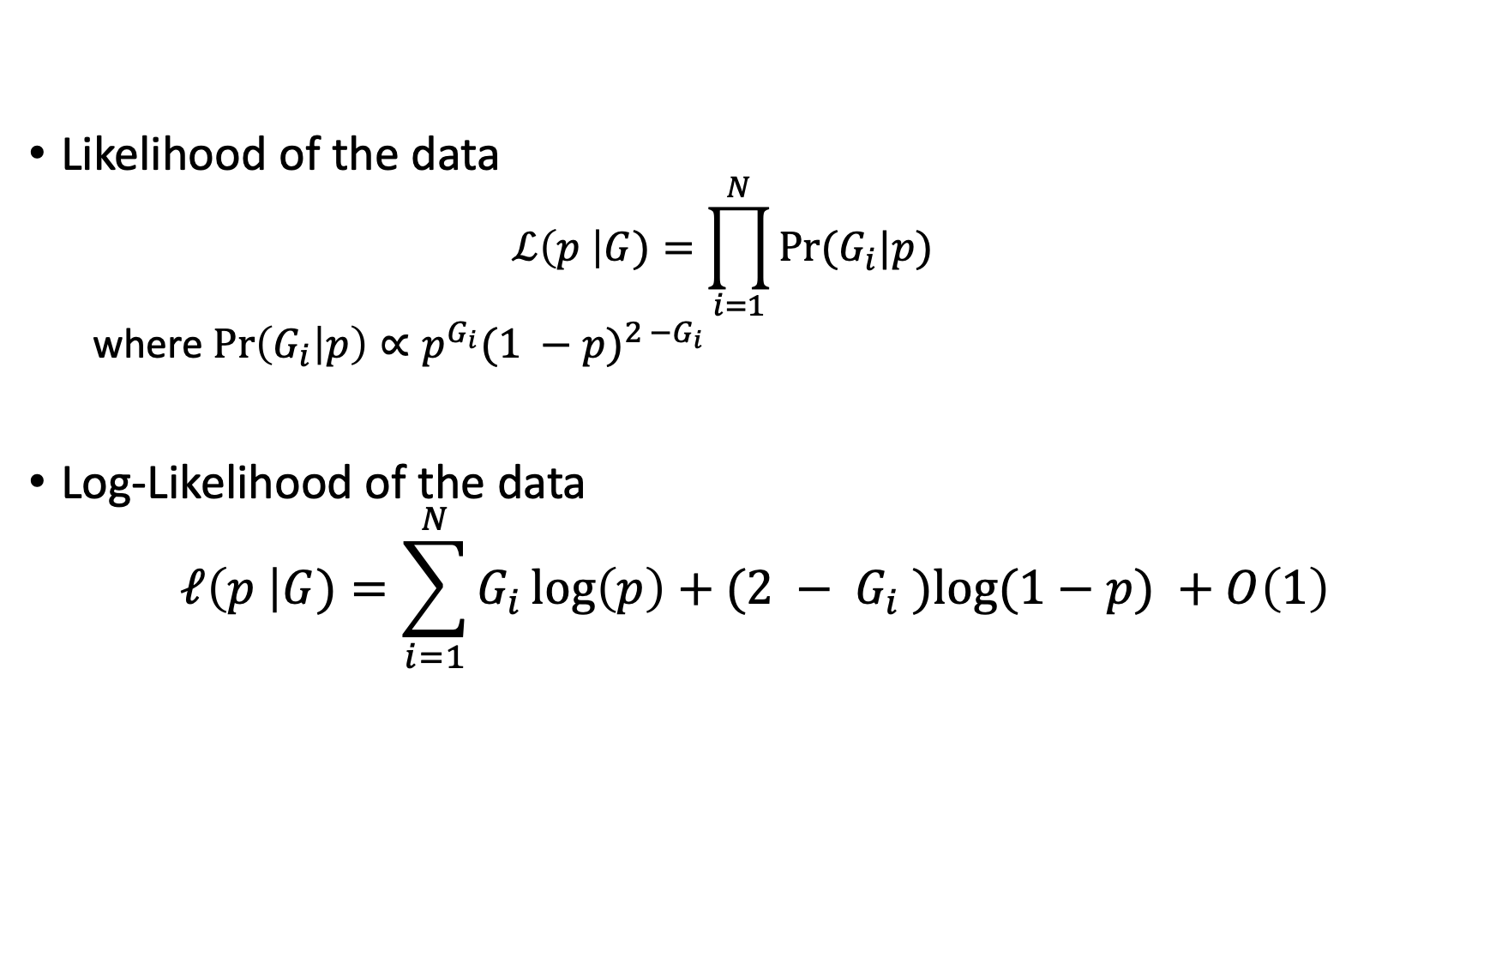
Maximum Likelihood Estimate for p under HWE
Likelihood of the data
$$ℒ\left(p \right|G)=\prod_{i=1}^{N}{Pr⁡(G_{i}|p)}$$
where $\operatorname{Pr}\left(G_{i} | p\right)∝p^{G_{i}}{(1 −p)}^{2 −G_{i}}$
Log-Likelihood of the data
$$ℓ\left(p \right|G)=\sum_{i=1}^{N}{G_{i}\log\left(p\right)+(2 − G_{i} )log⁡(1−p) }+O\left(1\right)$$

Slide 24
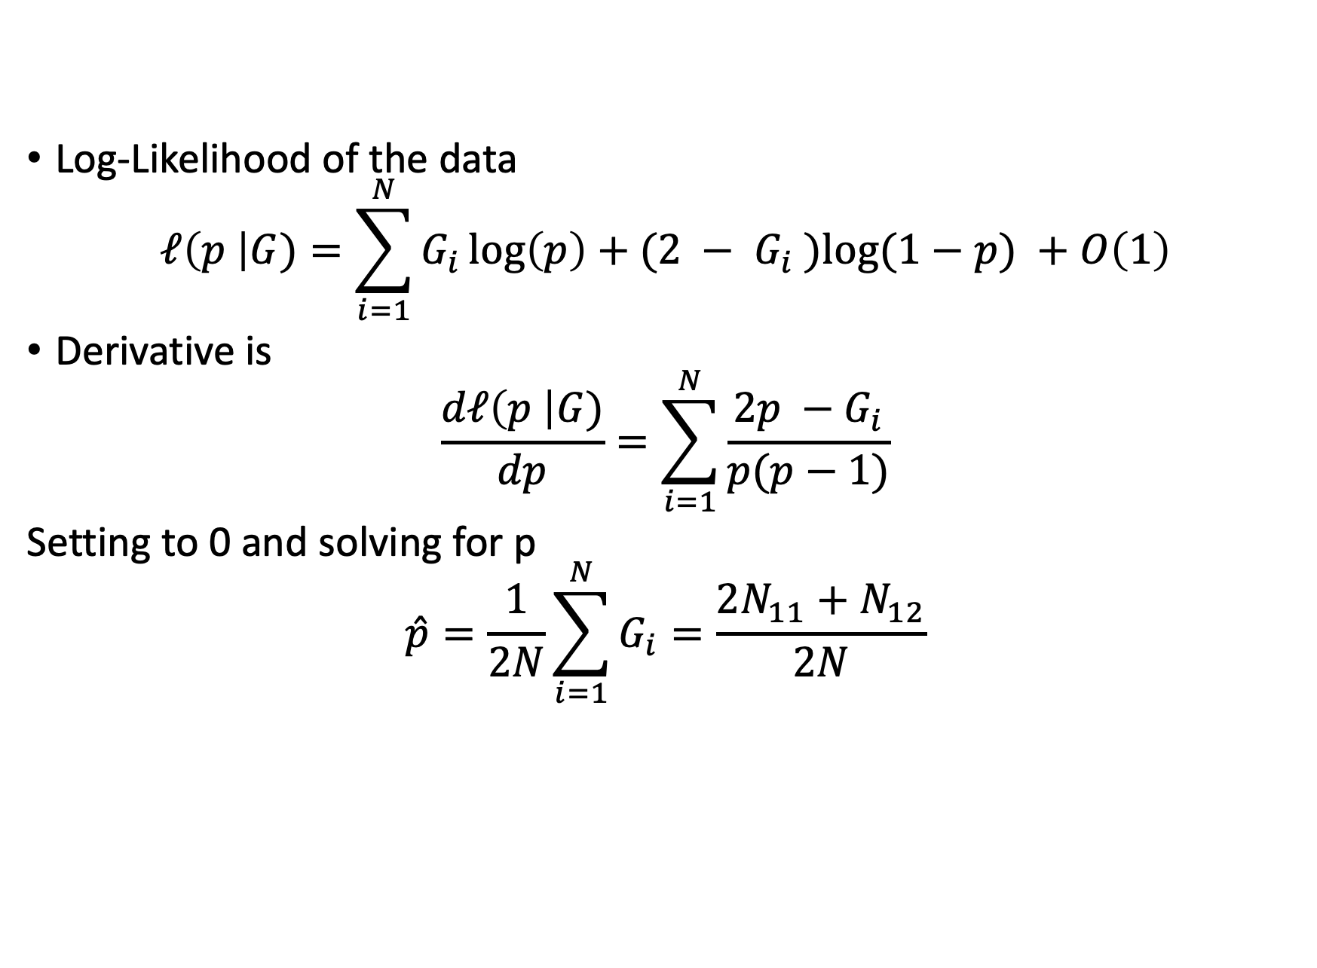
Maximum Likelihood Estimate for p under HWE
Log-Likelihood of the data
$$ℓ\left(p \right|G)=\sum_{i=1}^{N}{G_{i}\log\left(p\right)+(2 − G_{i} )log⁡(1−p) }+O\left(1\right)$$
Derivative is
$$\frac{dℓ\left(p \right|G)}{dp}=\sum_{i=1}^{N}{\frac{2p −G_{i}}{p(p−1)}}$$
Setting to 0 and solving for p
$$\hat{p}=\frac{1}{2N}\sum_{i=1}^{N}{G_{i}}=\frac{2N_{11}+N_{12}}{2N}$$

Slide 25
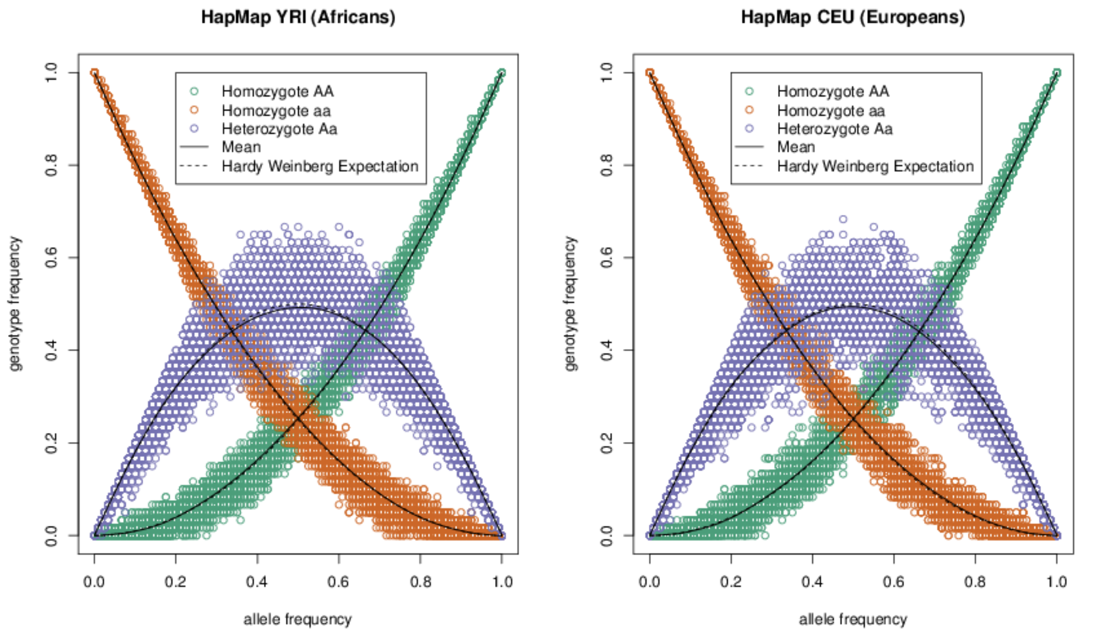
HWE in Continental Populations
https://github.com/cooplab/popgen-notes

Slide 26
Do “genes” mirror geography?
!? POP QUIZ !?

Slide 27
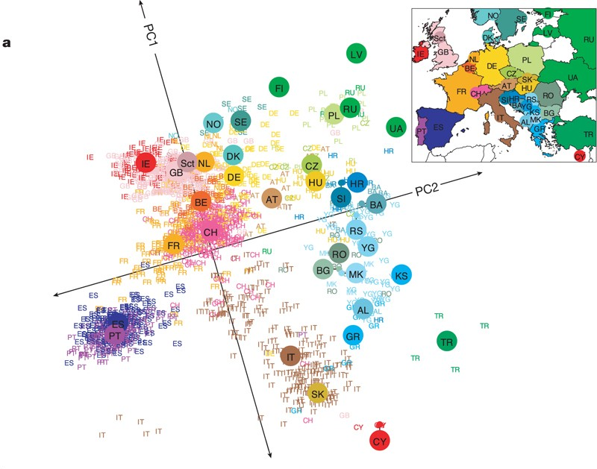
Genes mirror geography within Europe
Novembre, John, et al. Nature 2008

Slide 28
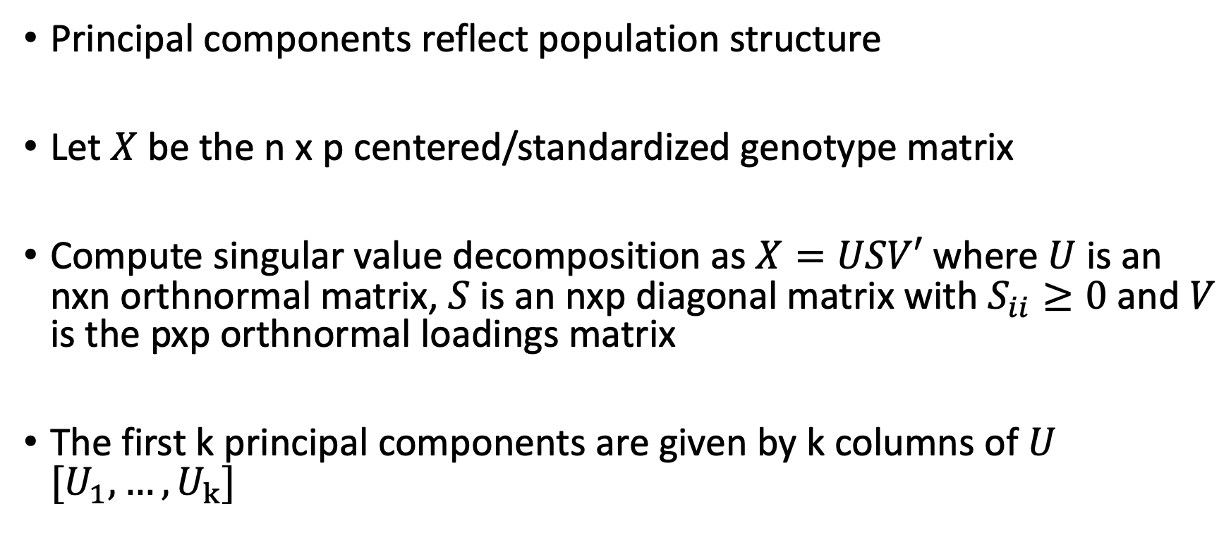
Genotyping principal component analysis
Principal components reflect population structure
Let $X$ be the n x p centered/standardized genotype matrix
Compute singular value decomposition as $X=USV′$ where $U$ is an nxn orthnormal matrix, $S$ is an nxp diagonal matrix with $S_{ii}≥0$ and $V$ is the pxp orthnormal loadings matrix
The first k principal components are given by k columns of $U$ $[U_{1},…, U_{k}]$
Cavalli-Sforza et al Science 1978 Patterson, Nick, et al. PloS Genet 2006

Slide 29
Genome-wide association studies

Slide 30
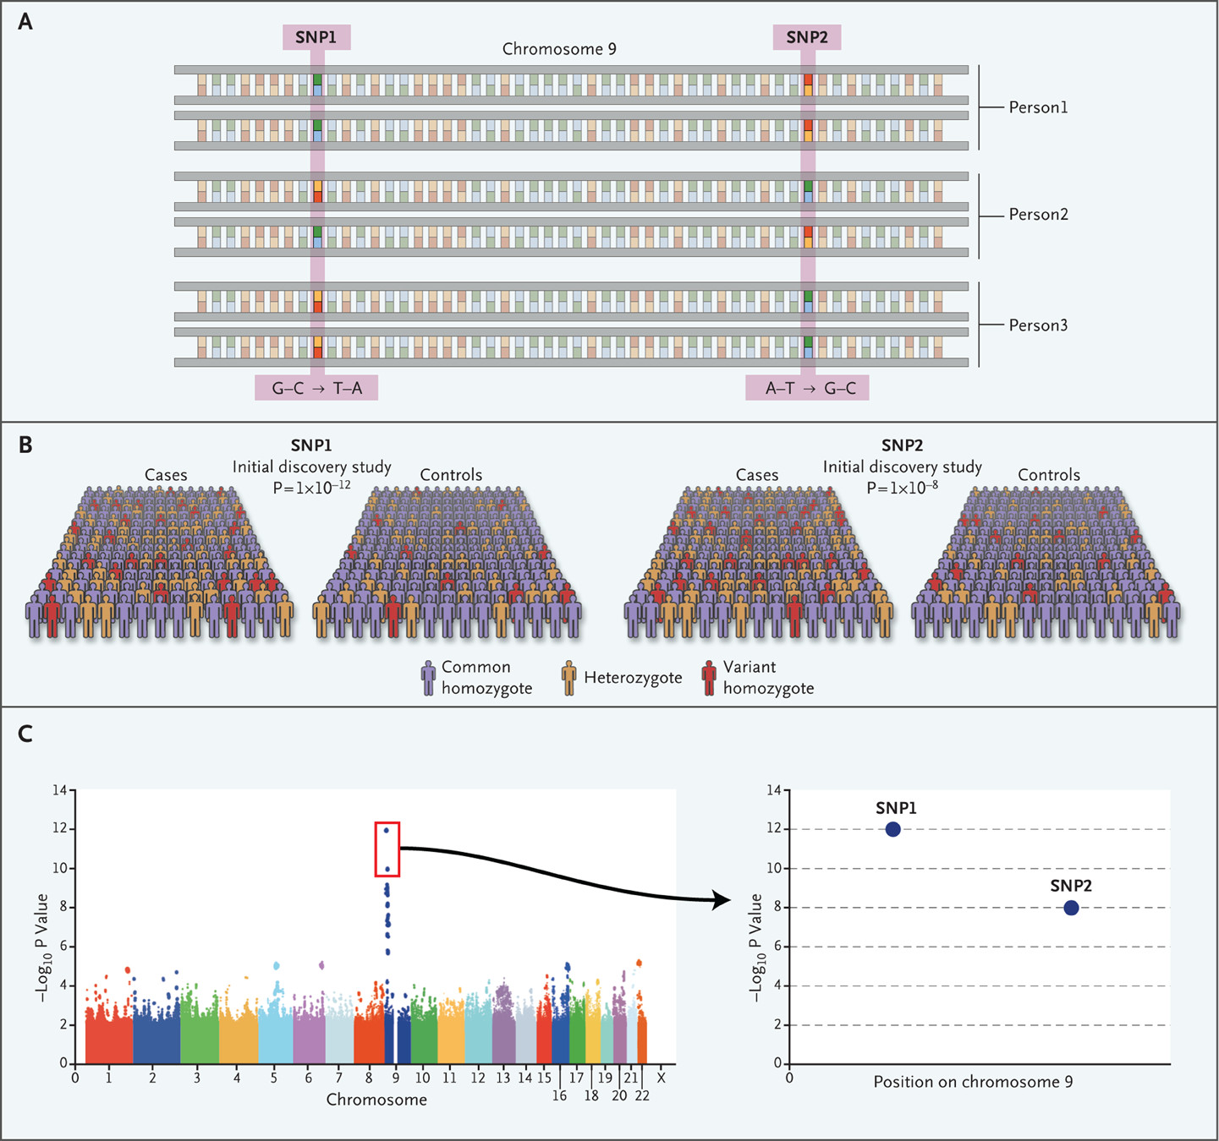
Genome-wide association study
Quantify common genetic variation (SNPs)
Large cohorts and simple models
Test for association between SNP and disease
Manolio TA. N Engl J Med 2010

Slide 31
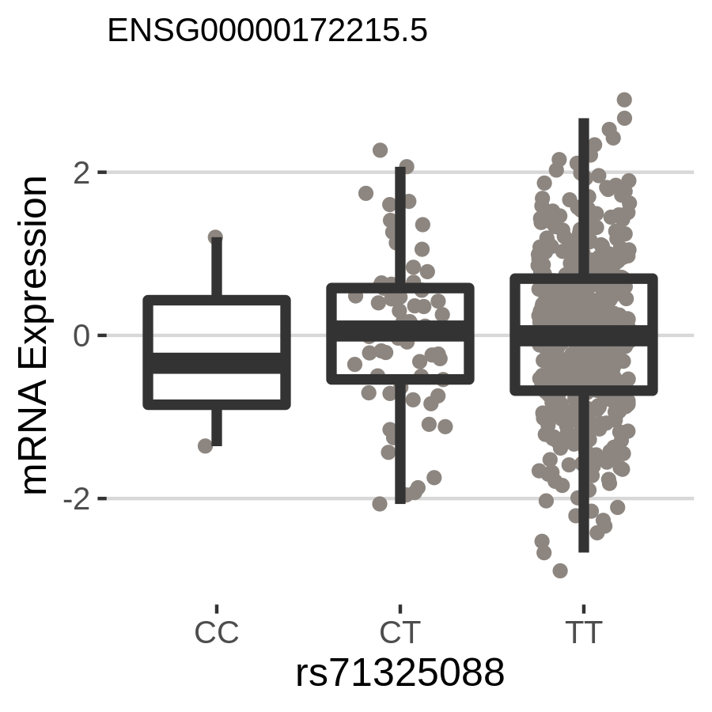
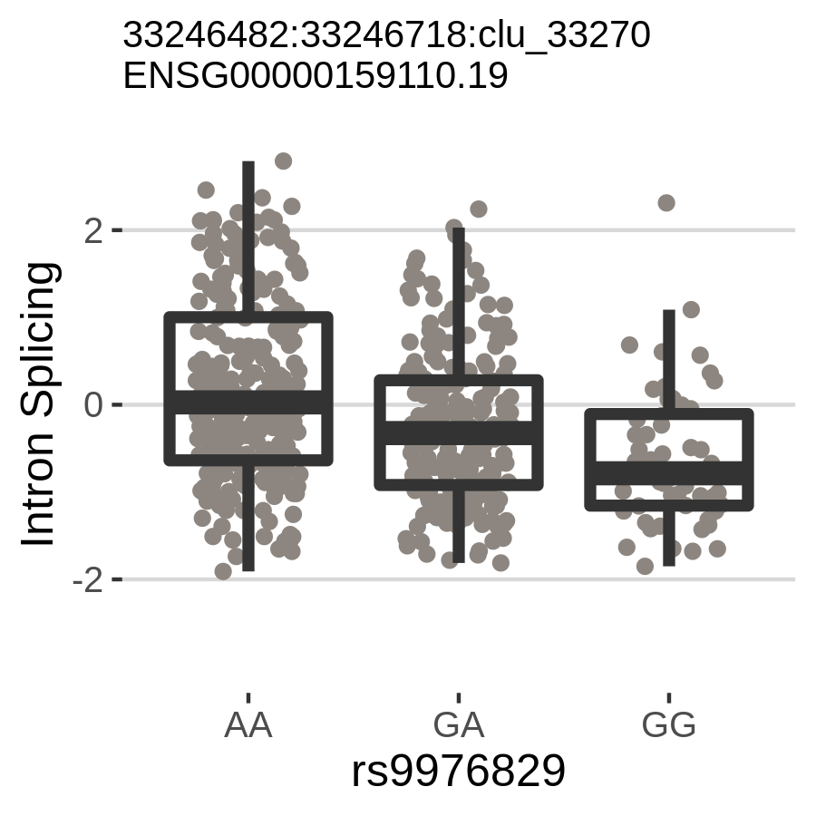
What is an “association”?
Let y be a quantitative phenotype measured in N individuals and let x be the genotype at a SNP
Does change in x track with change in y?
No!
Yes!
P = 0.93
P = 5.54e-11

Slide 32
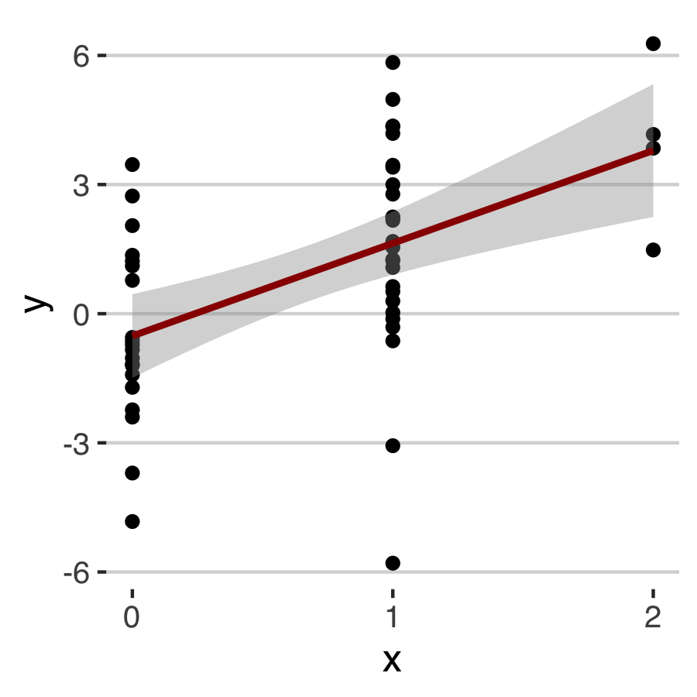
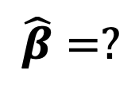
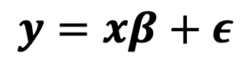
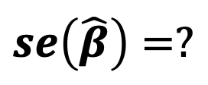
What is an “association”?
Let y be a quantitative phenotype measured in N individuals and let x be the genotype at a SNP
We can model the effect of x on y as β and “unexplained” signal as ε
Assume linear change in x -> y
$$y=xβ+ε$$
$$\hat{β}=?$$
$$se\left(\hat{β}\right)=?$$

Slide 33
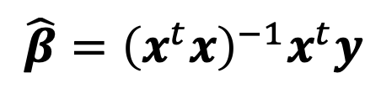
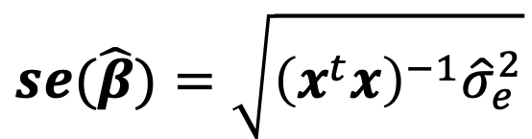
What is an “association”?
Let y be a quantitative phenotype measured in N individuals and let x be the genotype at a SNP
We can model the effect of x on y as β and “unexplained” signal as ε
Assume linear change in x -> y
$$y=xβ+ε$$
$$\hat{β}={\left(x^{t}x\right)}^{−1}x^{t}y$$
$$se(\hat{β})=\sqrt{{\left(x^{t}x\right)}^{−1}{\hat{σ}}_{e}^{2}}$$

Slide 34
What is an “association”?
Let y be a quantitative phenotype measured in N individuals and let x be the genotype at a SNP
We can model the effect of x on y as β and “unexplained” signal as ε
Assume linear change in x -> y
$$y=xβ+ε$$
$$\hat{β}={\left(x^{t}x\right)}^{−1}x^{t}y$$
$$se(\hat{β})=\sqrt{{\left(x^{t}x\right)}^{−1}{\hat{σ}}_{e}^{2}}$$
P = 1.08e-5

Slide 35
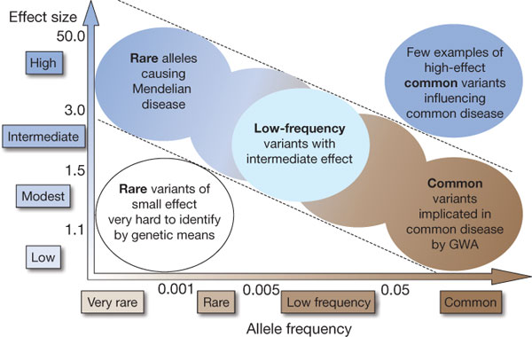
Effect size landscape
Manolio et al. Nature 461:747-753, 2009

Slide 36
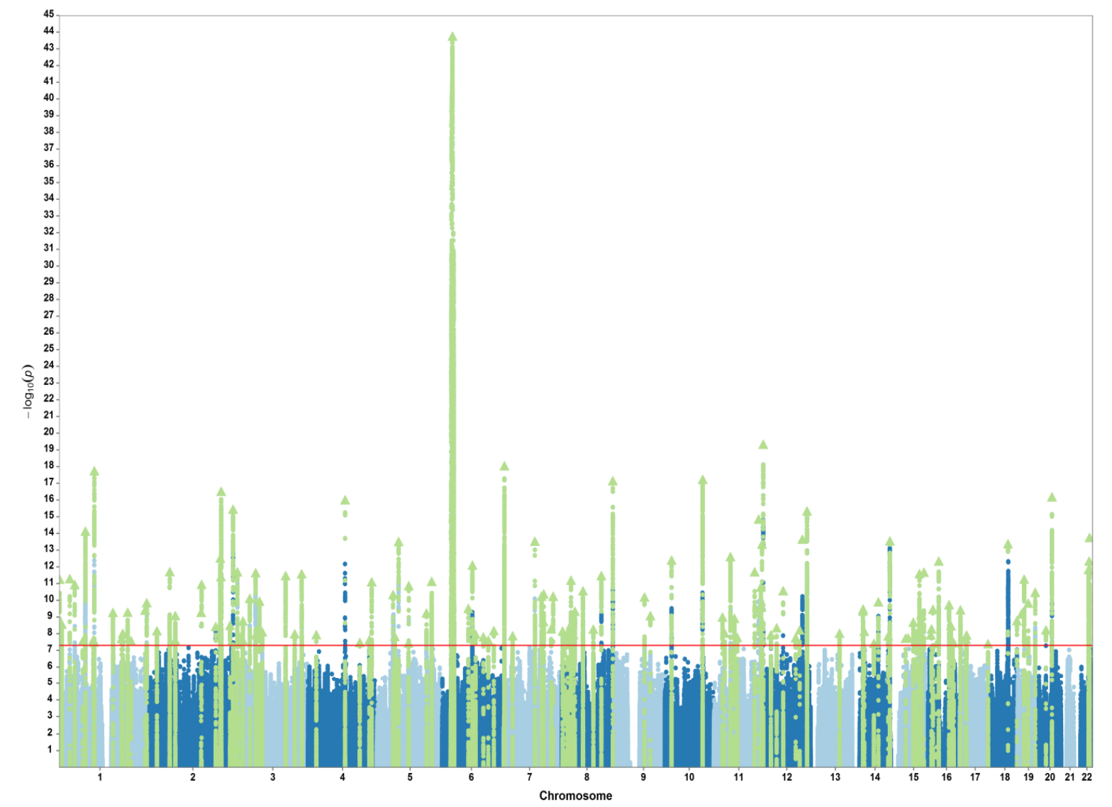
Schizophrenia GWAS ~ 2018
Pardinas et al. Nat Gen 2018

Slide 37
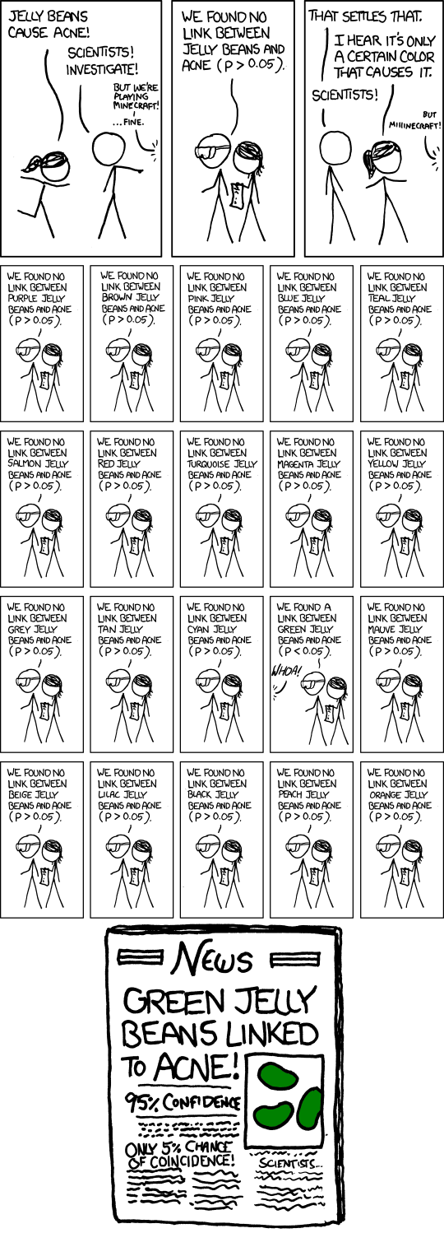
When is a result significant?
xkcd.com

Slide 38
When is a result significant?
xkcd.com

Slide 39
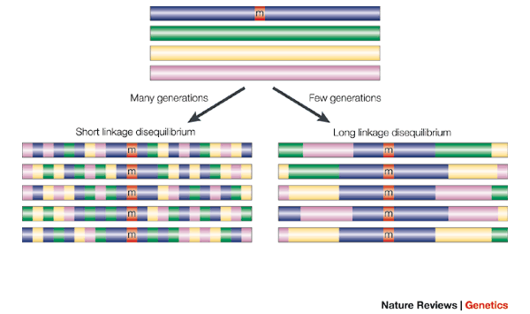
These blocks shrink over many generations due to repeated recombination

Slide 40
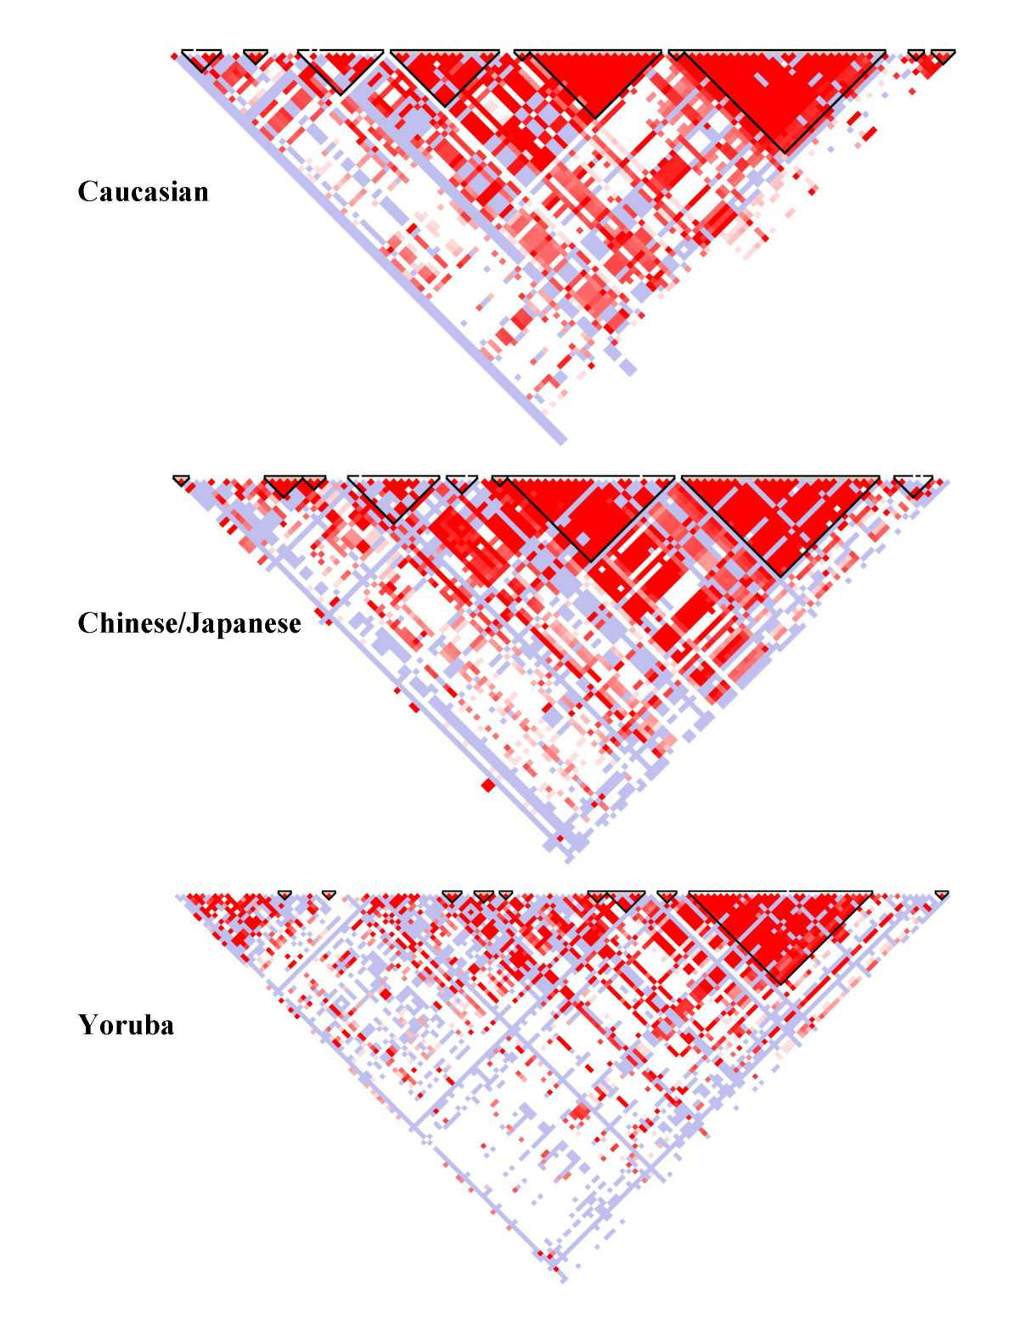
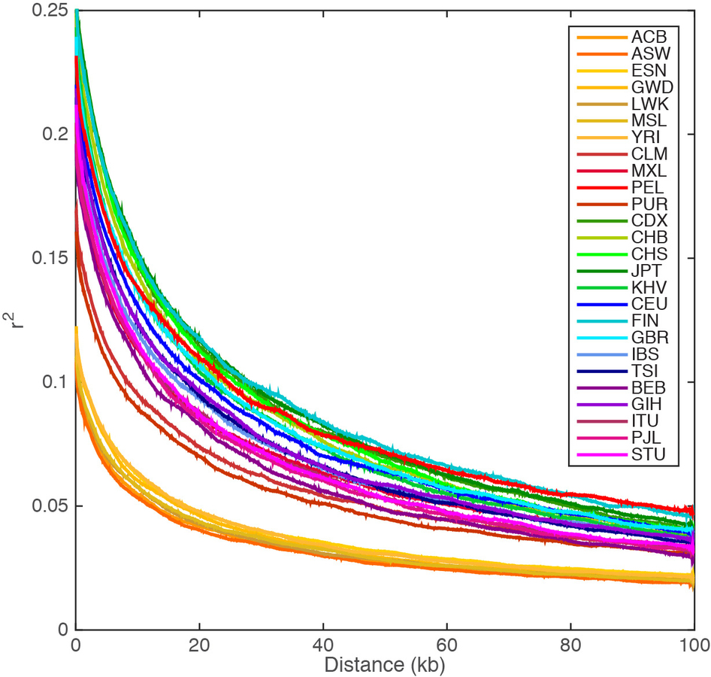
Some nearby variants are highly correlated
Recombination induces haplotype “blocks” of correlated SNPs
Linkage disequilibrium decays with distance
http://graphics.cs.wisc.edu/WP/vis10/archives/458-hapmap-linkage-disequilibrium-plot
A global reference for human genetic variation

Slide 41
Schizophrenia GWAS ~ 2018
Pardinas et al. Nat Gen 2018
Genome-wide significance
P = 5.0E-8

Slide 42
How to test for disease association?
Let y be a binary disease outcome measured in N individuals and let x be the genotype at a SNP
Let p₊ be the allele frequency in cases and p₋ allele frequency in controls, and p be the grand allele frequency

Slide 43
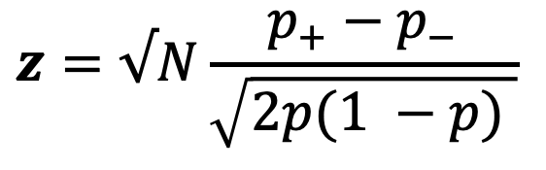
How to test for disease association?
Let y be a binary disease outcome measured in N individuals and let x be the genotype at a SNP
Let p₊ be the allele frequency in cases and p₋ allele frequency in controls, and p be the grand allele frequency
Test for differences in allele frequencies!
$$z=√N\frac{p_{+}−p_{−}}{\sqrt{2p(1 −p) }}$$

Slide 44
Association tests can be confounded by ancestry
Campbell et al. Nat Gen 2005
Campbell et al investigated height in European populations
Found association evidence at LCT
Differing allele frequencies across Europe
likely FP due to stratification

Slide 45
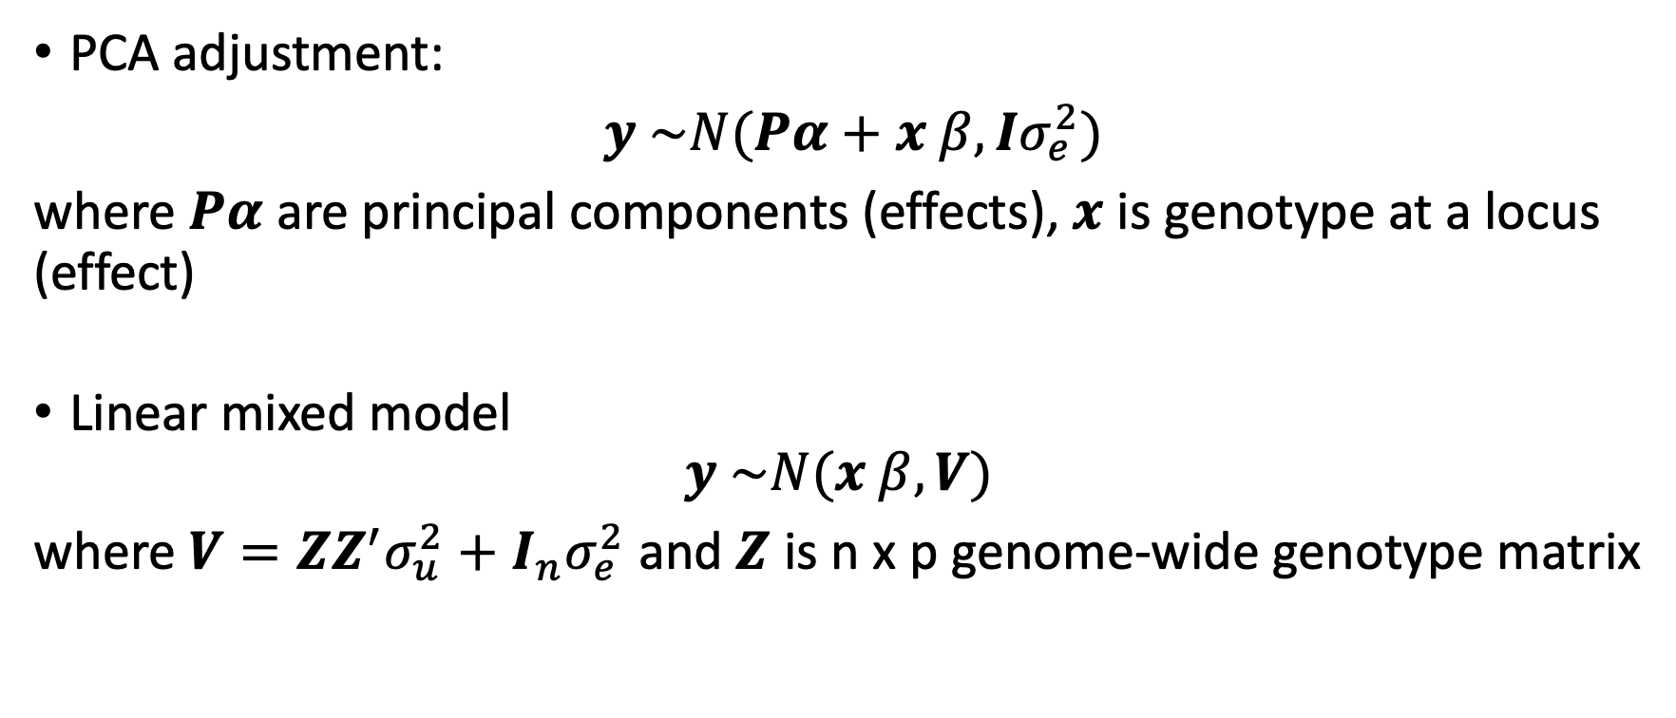
PCA vs Linear Mixed Models
PCA adjustment:
$y \sim N(Pα+x β, Iσ_{e}^{2})$
where $Pα$ are principal components (effects), $x$ is genotype at a locus (effect)
Linear mixed model
$$y \sim N(x β, V)$$
where $V=ZZ^{′}σ_{u}^{2}+I_{n}σ_{e}^{2}$ and $Z$ is n x p genome-wide genotype matrix
Loh, Po-Ru, et al. Nature genetics (2018) Lippert, Christoph, et al. Nature methods 2011

Slide 46
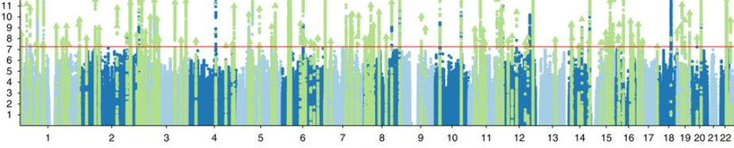
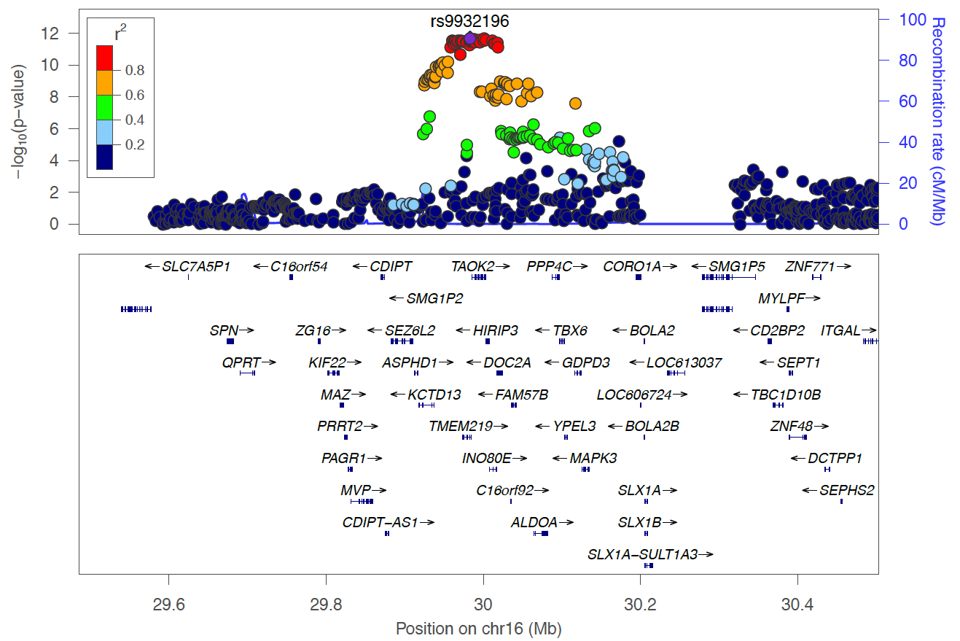
GWAS does not provide causal mechanisms
Pardinas et al. Nat Gen 2018
GWAS provides regions associated with disease risk
What are the mechanisms driving disease risk?
Most associations are non-coding
SNPs with regulatory function are strong candidates

Slide 47
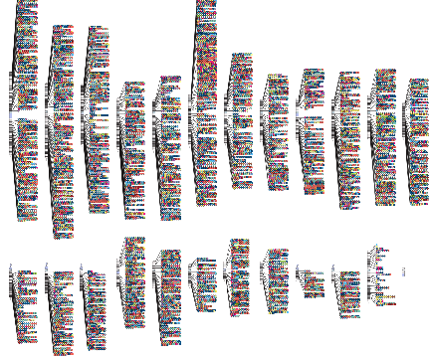
Genome-wide Association
GWAS Catalog: http://www.ebi.ac.uk/gwas
https://www.ebi.ac.uk/gwas/docs/diagram-downloads

Slide 48
Polygenic Risk Scores

Slide 49
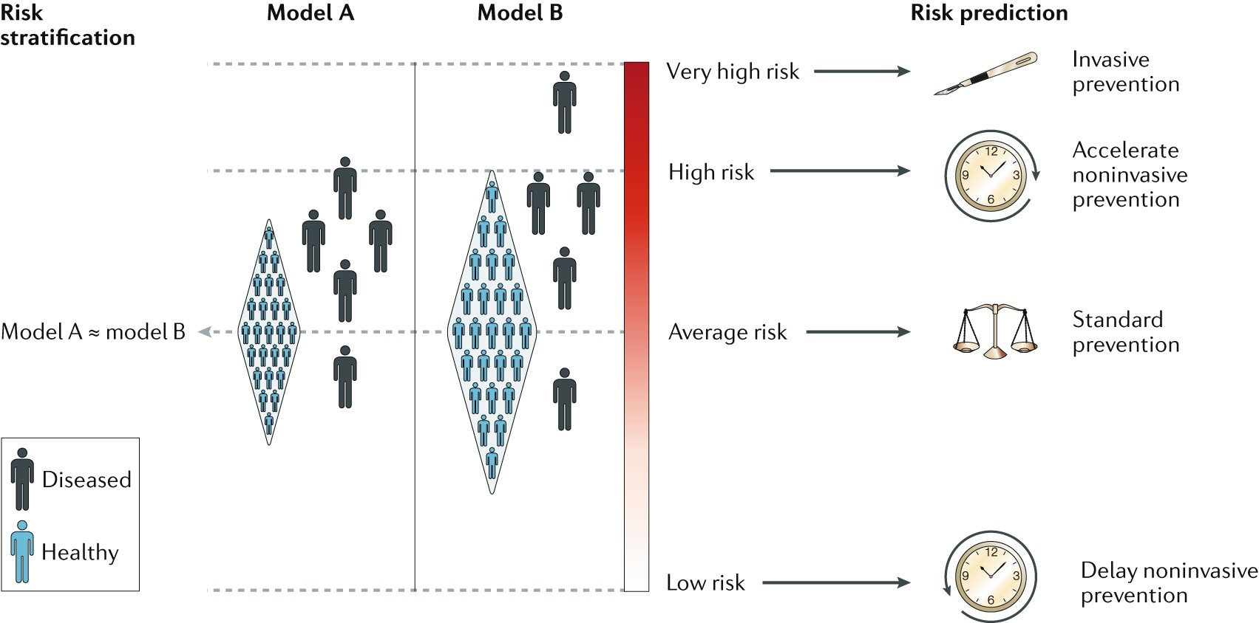
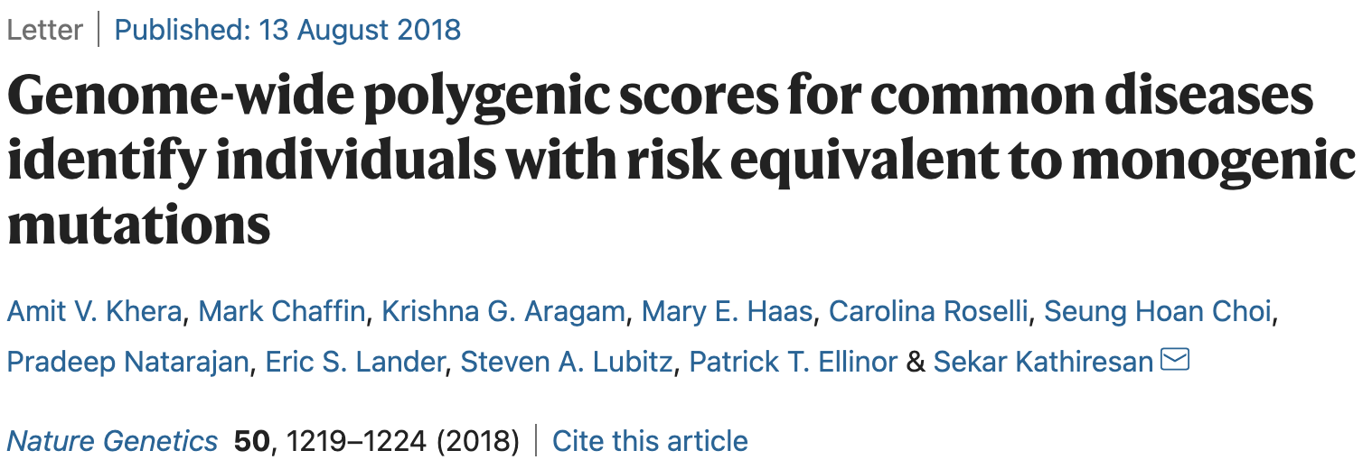
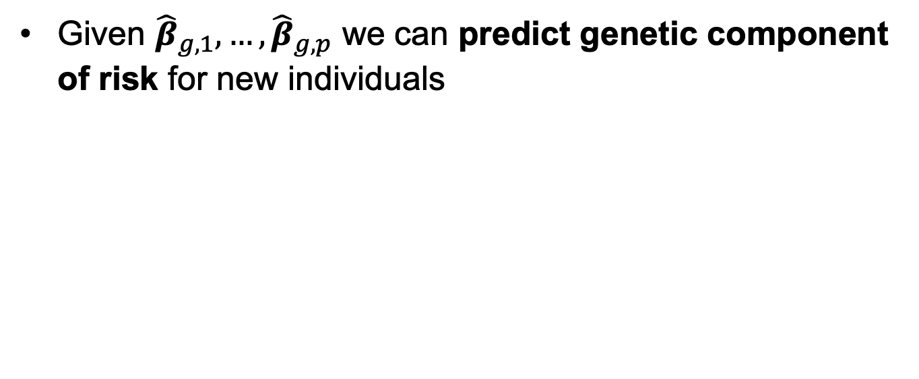
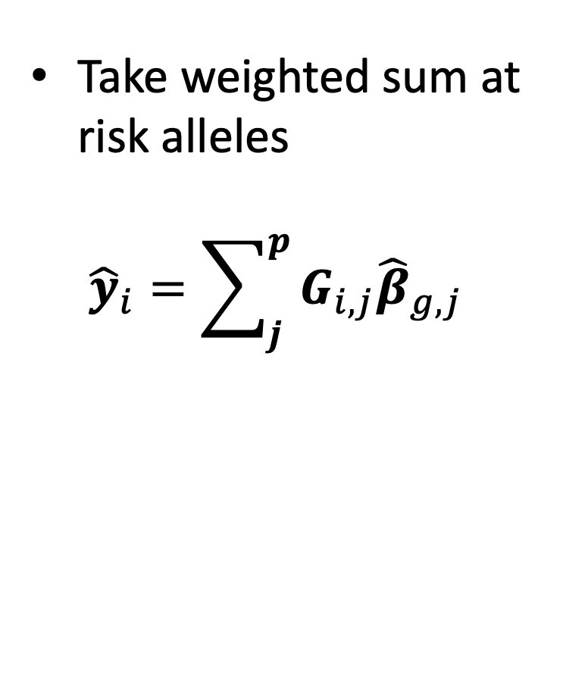
Polygenic Risk Prediction
Given ${\hat{β}}_{g,1}, …,{\hat{β}}_{g,p}$ we can predict genetic component of risk for new individuals
Take weighted sum at risk alleles
$${\hat{y}}_{i}=\sum_{j}^{p}{G_{i,j}{\hat{β}}_{g,j}}$$
Torkamani et al. Nat RevGen 2018

Slide 50
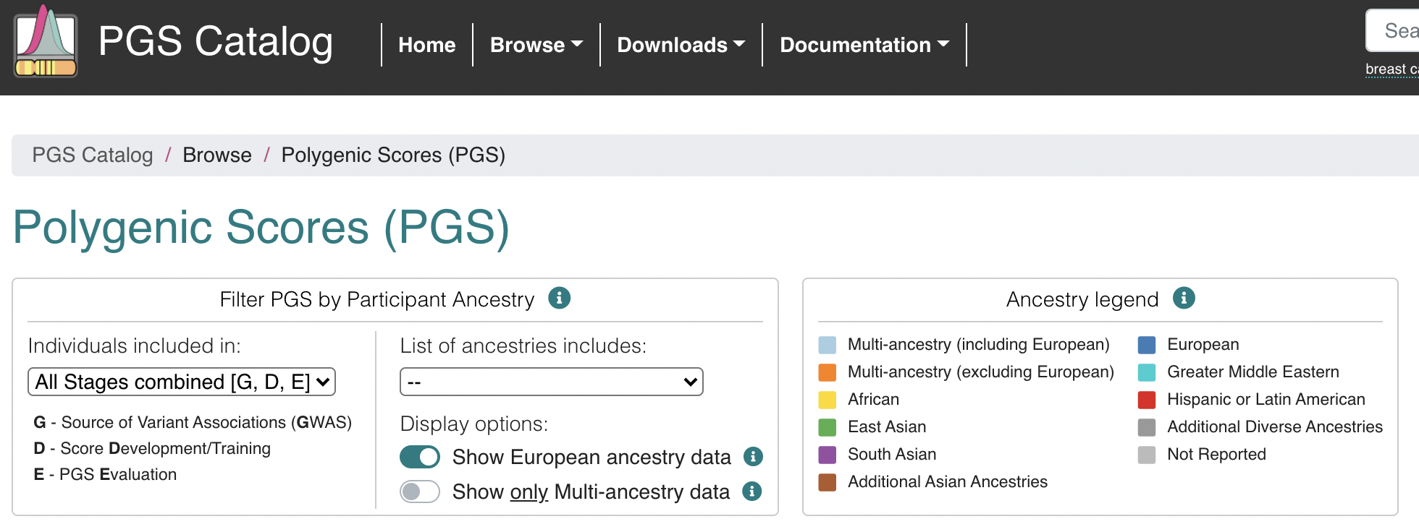
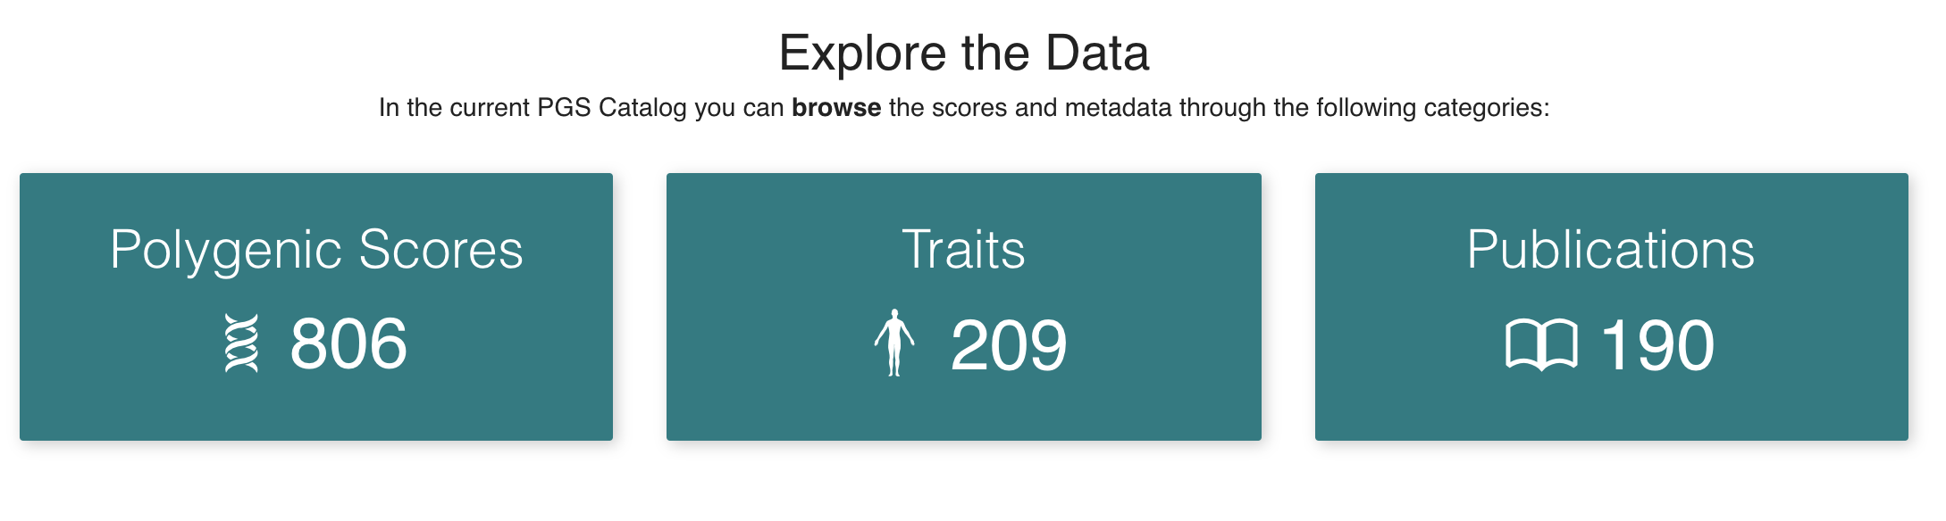
PRS Catalog
www.pgscatalog.org

Slide 51
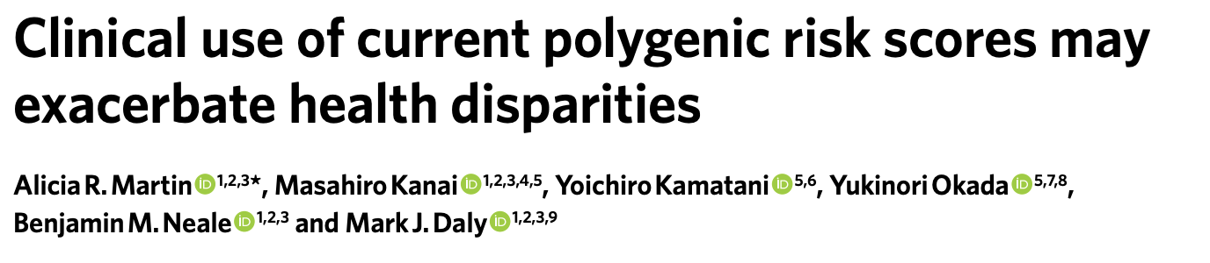
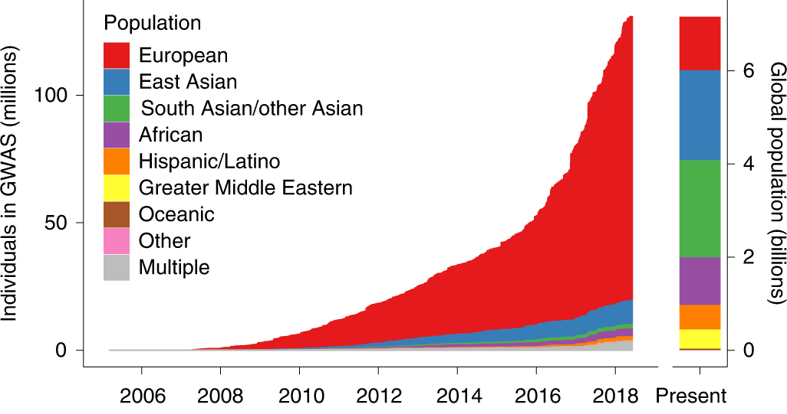
Caveats of SNP-based prediction

Slide 52
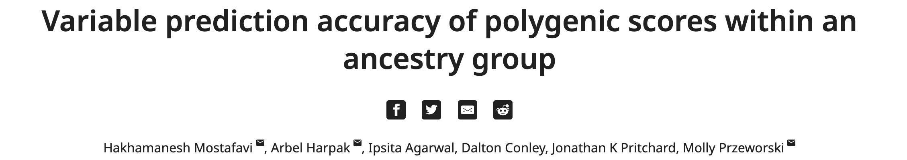

Caveats of SNP-based prediction
eLife

Slide 53


Diverse GWAS cohorts improves PRS portability

Slide 54
Conclusions

